Slide 1
Measurement of RTT (Round Trip Time) between any pair of active servers with error correction
Sri Harsha Chennavajjala
Teja Garidepally
Raj Kiran Reddy Munnangi
Vinay Kumar Matoori
Uday Chowdary Malineni
Aishwarya Rao Venkata
Pallavi Ramineni
Swetha Chandra Karroti

Slide 2
Necessity for Geolocation
Geolocation of IP addresses has important applications to targeted delivery of local news, advertising and other content over the Internet.
One approach to IP geolocation is to maintain a large distributed database containing mappings of IP addresses to geographical locations.

Slide 3
Necessity for Geolocation (Cont..)
Many sites rely on more or less accurate databases to determine the location of a customer for various reasons:
Determining regional distribution of the clients, local news delivery, targeted advertising, restriction of content delivery based on regional policies, etc.
Prevention/reduction of Internet frauds such as credit card fraud, identity theft, spam and phishing.
Application to intrusion detection.

Slide 4
Existing Techniques
The techniques which are in current existing scenario and are investigated by Padmanabhan and Subramanian are:
GeoTrack: Inferring the geographic location of an Internet host based on the DNS name of the host or another nearby node.
GeoCluster: Clustering the IP address space into likely collocated clusters.
GeoPing: Pinging the host, with geolocation of the IP address performed by correlating ping delays.

Slide 5
Existing Techniques (Cont..)
GeoPing employs active probes to measure delays among a set of landmark nodes with known locations.
Such delay measurements can be performed by a distributed network of servers.
Such a network of servers can be self-calibrating and potentially able to detect when a target IP address has changed its geographical coordinates significantly.

Slide 6
Existing Techniques (Cont..)
None of these techniques is perfect. Each has its strengths and weaknesses.
The median error in estimate of location varies from 28 km to several hundred kilometres depending on the technique used and the nature of the hosts being located.
The accuracy needed is a function of the application.

Slide 7
Proposed System
The proposed system which is used to track the geolocation of a server is based on RTT.
In telecommunications, the round-trip delay time (RTD) or round-trip time (RTT) is the length of time it takes for a signal to be sent plus the length of time it takes for an acknowledgment of that signal to be received.
This time delay therefore consists of the propagation times between the two points of a signal.

Slide 8
Factors on which RTT depends
The speed with which intermediate nodes and remote server function.
The number of other requests handled by intermediate nodes and remote server.
The number of nodes between source and destination.
The physical distance between the source and destination.
The data transfer rate of source internet’s connection.
The presence of interference in the circuit.
The amount of traffic on LAN to which the end user is connected.
The nature of the transmission medium.

Slide 9
Parameters on which RTT depends
Queueing delay: It is the time a job waits in a queue until it gets executed.
Network delay: Network delay is an important design and performance characteristic of a computer network or telecommunication network.
The delay of a network specifies how long it takes for a bit of data to travel across the network from one node or endpoint to another. It is typically measured in multiples or fractions of seconds. Delay may differ slightly, depending on the location of the specific pair of communicating nodes.

Slide 10
Objective
In this project we have to develop a RTT measurement system which will measure the RTT between any pair of server through exchange of files with error correction.
In the following slides we will explain the steps which we have done to implement this system.

Slide 11
Resources we have used
Ubuntu Linux
SCP/SSH
MySQL
gcc compiler
PlanetLab
Matlab

Slide 12
Working with PlanetLab
PlanetLab is a global research network that supports the development of new network services.
Since the beginning of 2003, more than 1,000 researchers at top academic institutions and industrial research labs have used PlanetLab to develop new technologies for distributed storage, network mapping, peer-to-peer systems, distributed hash tables, and query processing.

Slide 13
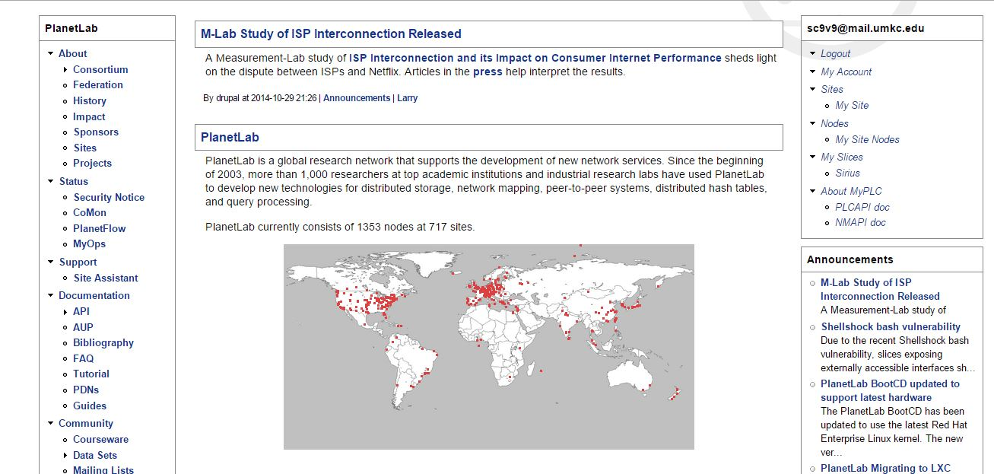
Working with PlanetLab
We have created an account in PlanetLab.

Slide 14
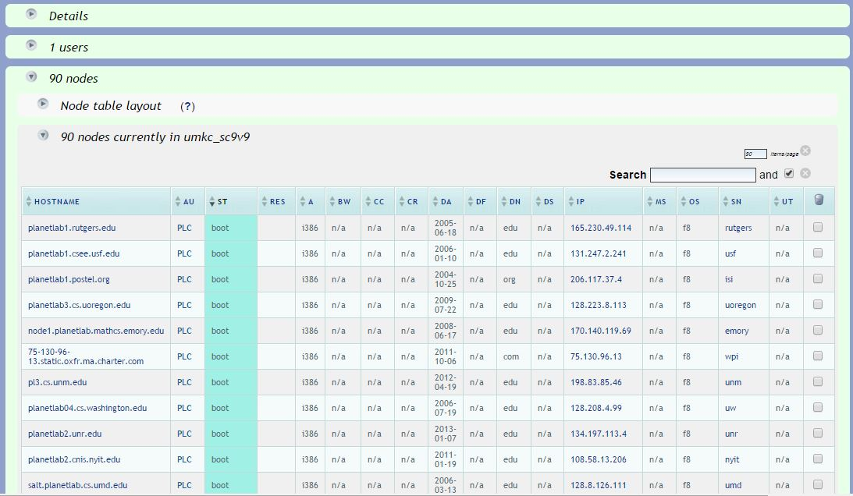
Working with PlanetLab(Cont..)
A slice is allocated to our team and we have added 90 nodes to our slice

Slide 15
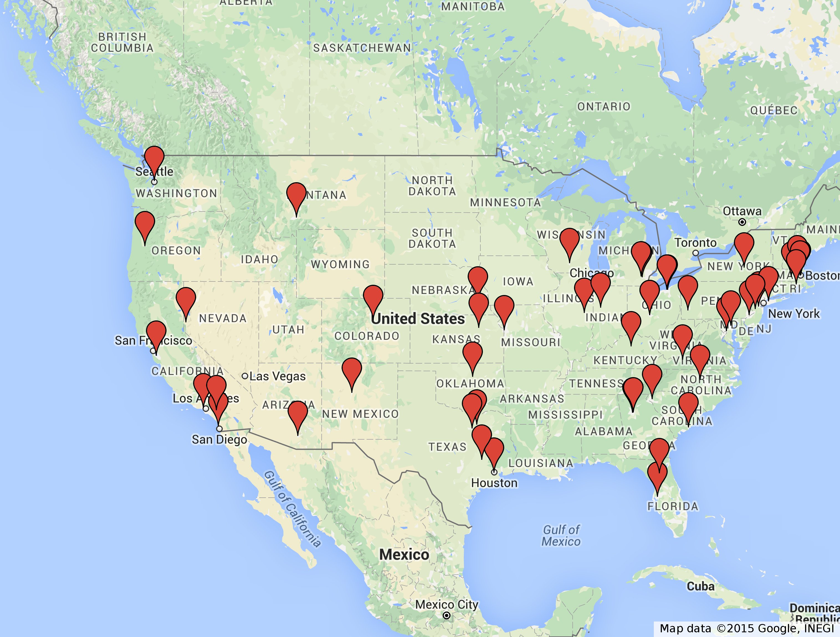
Geographically diversified nodes

Slide 16
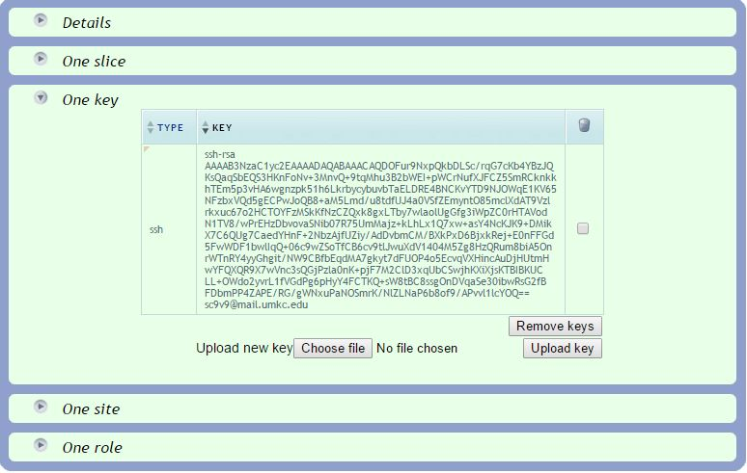
Working with PlanetLab(Cont..)
Generated a public key and private key using ssh keygen and uploaded public key in PlanetLab

Slide 17
Environment Setup
After uploading the key into our slice it is propagated to the nodes and we got access to the nodes.
We have created 5 text files of different sizes 32B,1KB,256KB,512KB and 1MB.
We have maintained a file nodesList.txt which contains list of all the nodes that are present in our slice.
By using scp command, we have placed all these files in each and every node.

Slide 18
Environment Setup(Cont..)
Installed gcc to run c files as it is not available default in nodes , using “sudo yum install gcc –nogpgcheck”.
We have used socket communication mechanism to establish connection among the nodes.

Slide 19
Application Programs
The following c-programming and shell scripting files are used for communication between nodes.
serverv5.c:
This is a concurrent server that can handle requests from multiple clients simultaneously.
This program gets a file name from the client, checks if the file is available. If the file is available then sends the file to client.

Slide 20
Application Programs(Cont ..)
clientv10.c
This program is used to connect to server and request for service.
After the connection is established, client receives file from server and closes connection after completion of file receiving.
Client collects 5 files from server and also calculates the time taken to collect each of these files.
Client logs calculated delays, source node, destination node, filename, time stamps values in to a file.
Generated log will be in this format RTT_log_<nodename>.log

Slide 21
Application Programs(Cont ..)
startStopServer.sh
This script starts or stop the server based on the parameter given to the script.
server.sh
This script calls startStopServer.sh script on the remote node to start or stop the server application.
It takes nodesList.txt file as input. And this script takes start or stop as one parameter.

Slide 22
Application Programs(Cont ..)
startClient.sh:
This script starts the client application, This takes nodesList.txt as input file which contains hostnames of all nodes.
stopClient.sh:
This script stops the client application.
Checks for any process related to client is running and kills it to stop the client.
client.sh
This script calls stopClient.sh and startClient.sh on the remote node to stop or start client application.
It takes nodesList.txt file as input. And this script takes start or stop as one parameter.

Slide 23
Application Programs(Cont ..)
downloadRTT.sh :
This script collects all log files from all nodes and merges them into one file.
This takes nodesList.txt file as input.
Saves the merged log file on local machine.
loadDownloadDetails_bkp.sql
This sql file loads the log file data in to database downloaddetails_bkp.

Slide 24
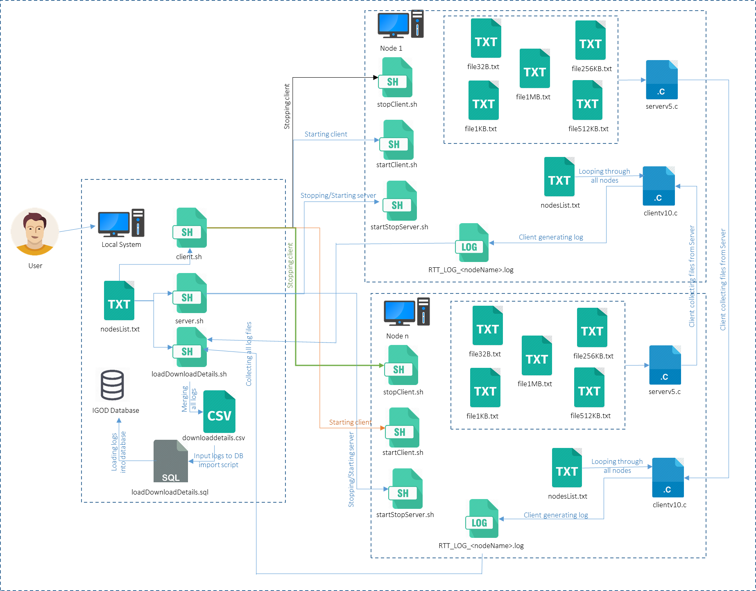
RTT Architecture

Slide 25
Database Content
We have used MySQL as database server.
We have created a database name IGOD and the tables in the database are as follows.
nodes
distofnodes
downloaddetails_bkp
View
DDR

Slide 26
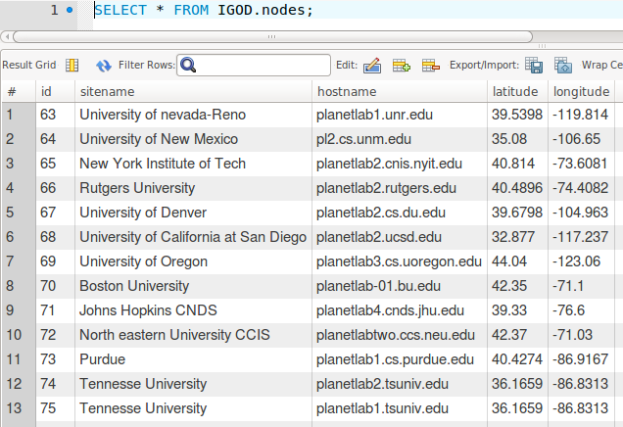
Database content(Cont ..)
nodes: This table stores the sitename, hostname, latitude and longitude of all nodes. Which will be used while calculating distance

Slide 27
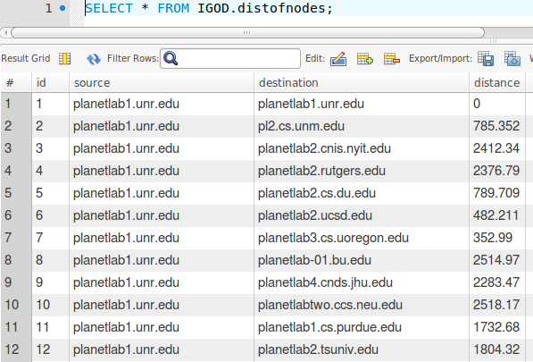
Database content(Cont ..)
distofnodes: This table stores the distance between any of two nodes

Slide 28
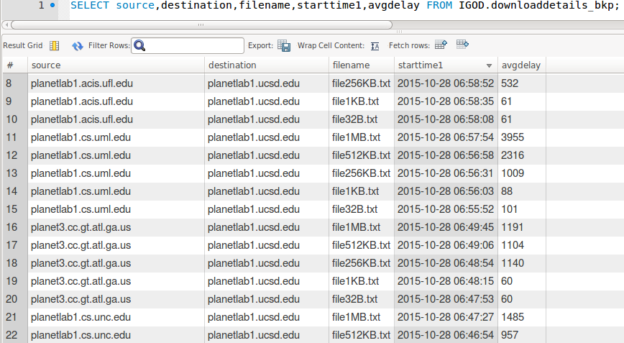
Database content(Cont ..)
downloaddetails_bkp: This table stores source node, destination node, file name, start times, end times, delays and the average delay.

Slide 29
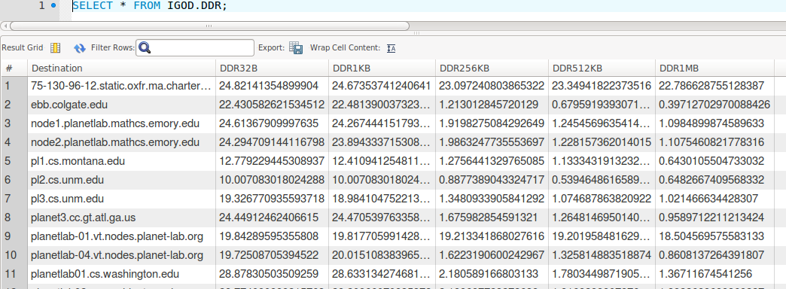
Database content(Cont ..)
DDR: This is a view that is generated from downloaddetails_bkp table and stores average DDR for all nodes of all files. Here average DDR is calculated from all DDR’s that is calculated for one source to all destinations.This view is updated whenever downloaddetails_bkp table is updated.

Slide 30
Network Tuning
There are several factors that affect the optimized data transfer.
In computer networking, RWIN (TCP Receive Window) is the amount of data that a computer can accept without acknowledging the sender.
If the sender has not received acknowledgement for the first packet it sent, it will stop and wait and if this wait exceeds a certain limit, it may even retransmit.

Slide 31
Network Tuning
We analysed the RTT values for different RWIN values and adjusted the receive window in our application.
We also optimizing the RTT values by collecting the files multiple times and calculating the average of delay.
To observe variations in RTT, we collected the files on different times of the day.

Slide 32
Data Analysis
Data Analysis is the process of systematically applying statistical and/or logical techniques to describe and evaluate data.
Here we try to find the predicted distance from the source to host, based on the network delay
Relationship between network delay and geographical distance

Slide 33
Data Analysis(Cont..)
Calculation of DDR
Calculating Estimated Distance
Distance Error
Plotting of Graphs
Error Correction Techniques

Slide 34
Calculation of DDR
Here we use the collected data and find the location of host based on the delay
Relation between distance and delay gives us the DDR
Calculated distance to delay ratio of each node for each file size:
DDR=Distance(source,Host)/rtt(Source,Host)

Slide 35
Query for DDR calculation
SELECT
AVG(b.distance / a.avgdelay) AS DDR
FROM
downloaddetails_bkp a
JOIN distofnodes b
WHERE
a.source = b.source
AND a.destination = b.destination
AND a.filename = ‘file1KB.txt’
AND a.source <> a.destination
GROUP BY a.destination;

Slide 36
Calculating Est. Distance
Average of DDR is calculated for each node
Average DDR is data transfer rate of the source to all other hosts in the network
Estimated distance to host is calculated by multiplying the DDR to the rtt(round trip time) from that source to host
Estimated Distance=DDR*rtt(Source,Host)

Slide 37
Query for finding Est.Distance
SELECT
given_delay*DDR32KB
FROM
DDR
WHERE
destination=“ebb.colgate.edu”;

Slide 38
Distance Error
Distance error is difference between estimated distance and actual distance
Distance Error=Actual distance-Estimated Distance
We try to reduce the distance error by using error correction methods

Slide 39
Data Presentation-Graphs
We have plotted different types of graphs and they are
CDF of delay vs distance.
Distribution of measurements for 4 nodes in our planetlab set.
Q-Q plot for 4 planetlab nodes.

Slide 40
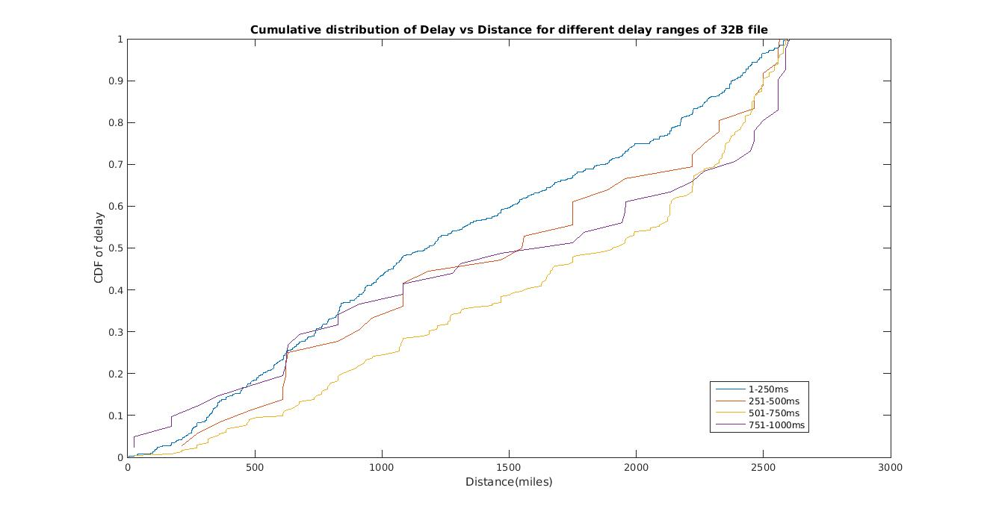
Data Presentation-Graphs(Cont..)
CDF of delay vs distance for 32B file
X-axis: distance
Y-axis: CDF of different delay ranges

Slide 41
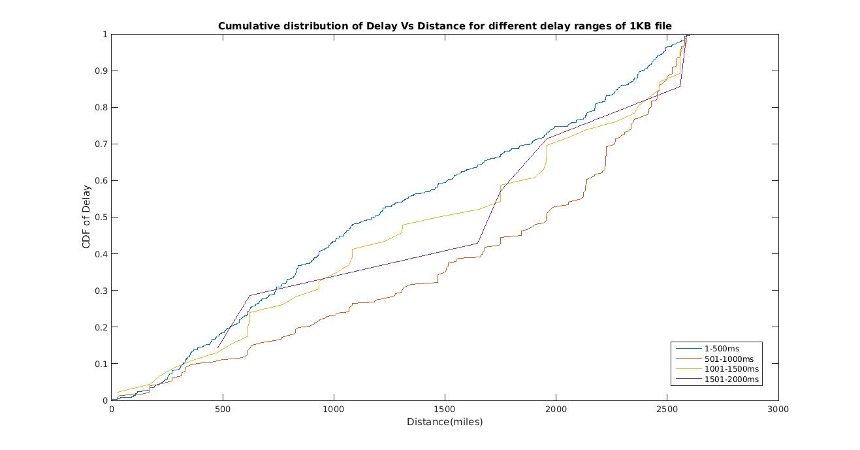
Data Presentation-Graphs(Cont..)
CDF of delay vs distance for 1KB file
X-axis: distance
Y-axis: CDF of different delay ranges

Slide 42
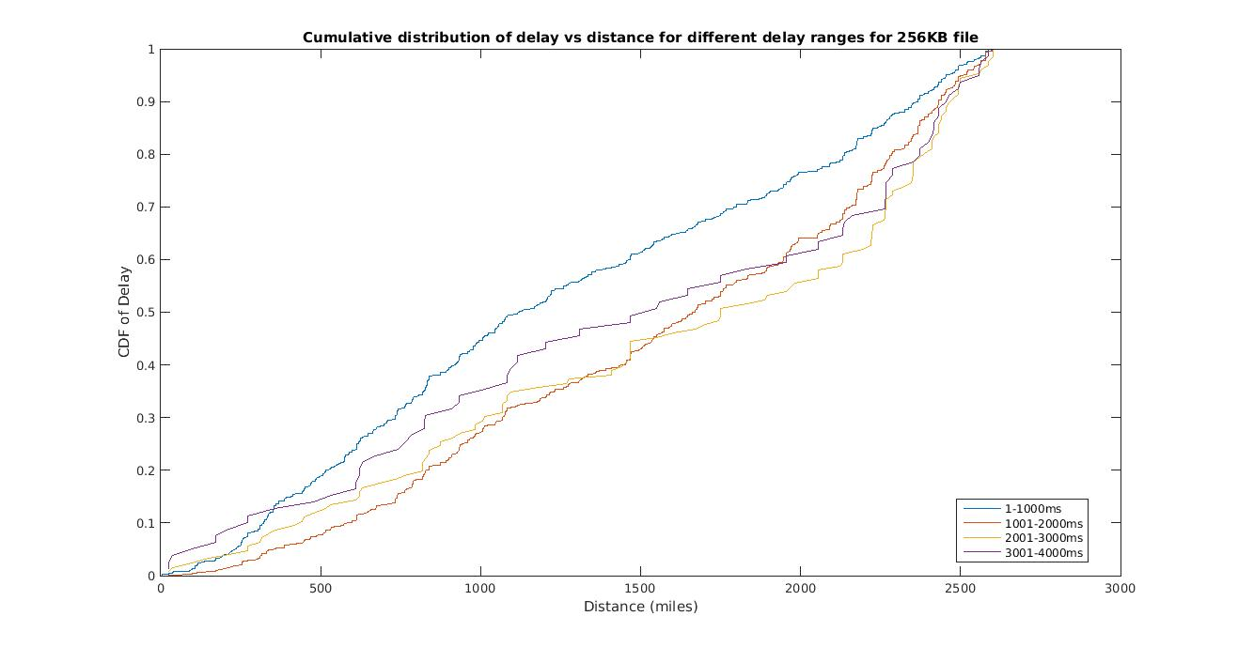
Data Presentation-Graphs(Cont..)
CDF of delay vs distance for 256KB file
X-axis: distance
Y-axis: CDF of different delay ranges

Slide 43
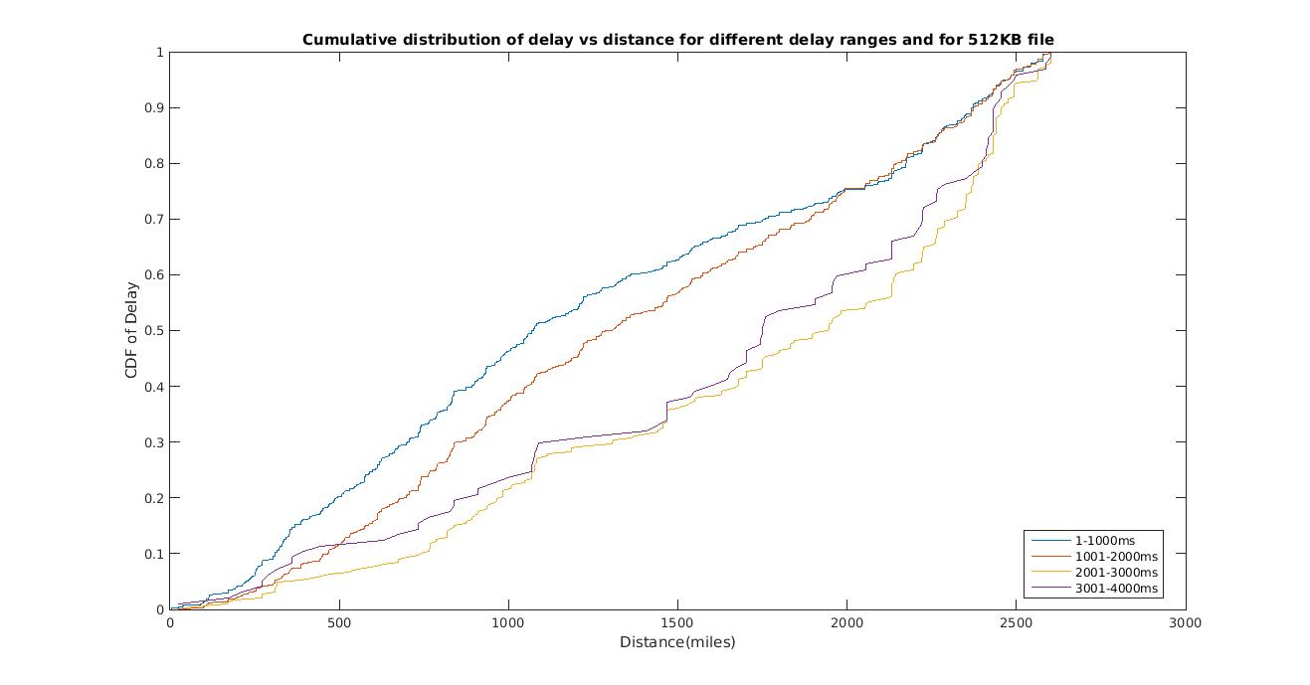
Data Presentation-Graphs(Cont..)
CDF of delay vs distance for 512KB file
X-axis: distance
Y-axis: CDF of different delay ranges

Slide 44
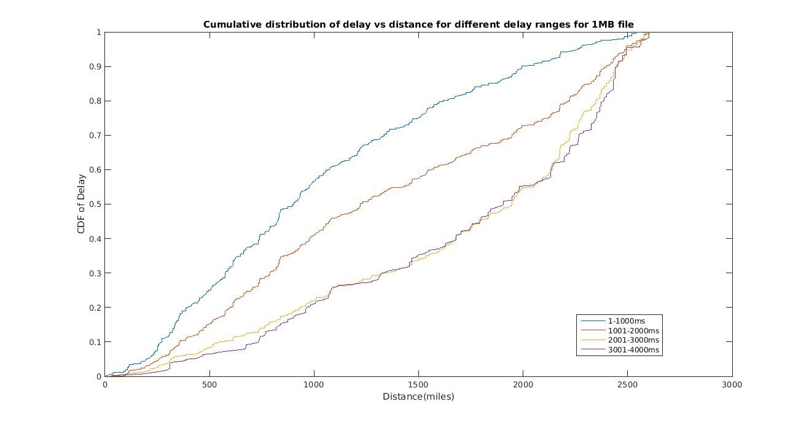
Data Presentation-Graphs(Cont..)
CDF of delay vs distance for 1MB file
X-axis: distance
Y-axis: CDF of different delay ranges

Slide 45
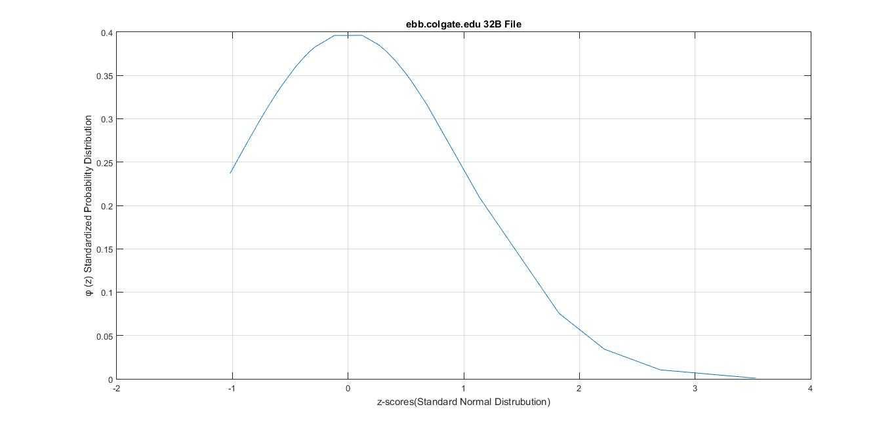
Data Presentation-Graphs(Cont..)
Distribution of measurements for ebb.colgate.edu for 32B file
X-axis: z scores for standard normal distribution
Y-axis: φ (z)

Slide 46
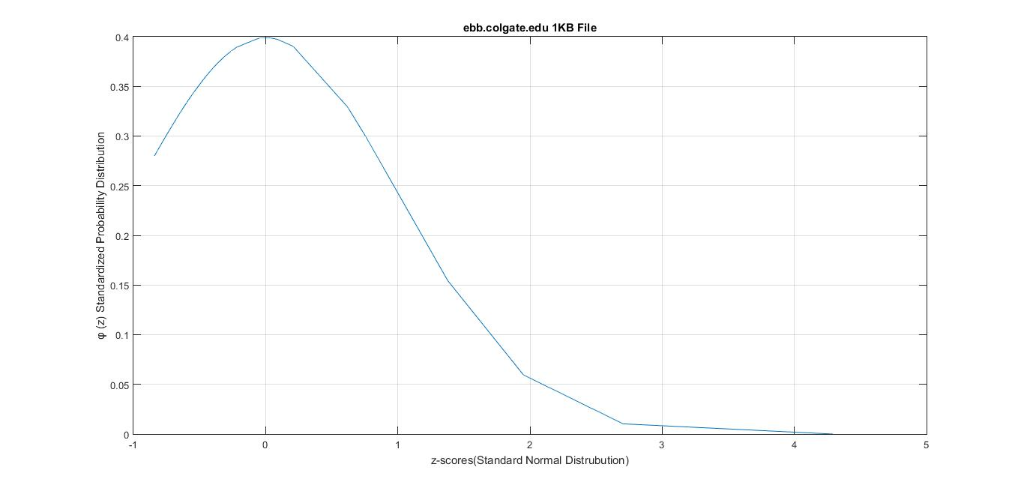
Data Presentation-Graphs(Cont..)
Distribution of measurements for ebb.colgate.edu for 1KB file

Slide 47
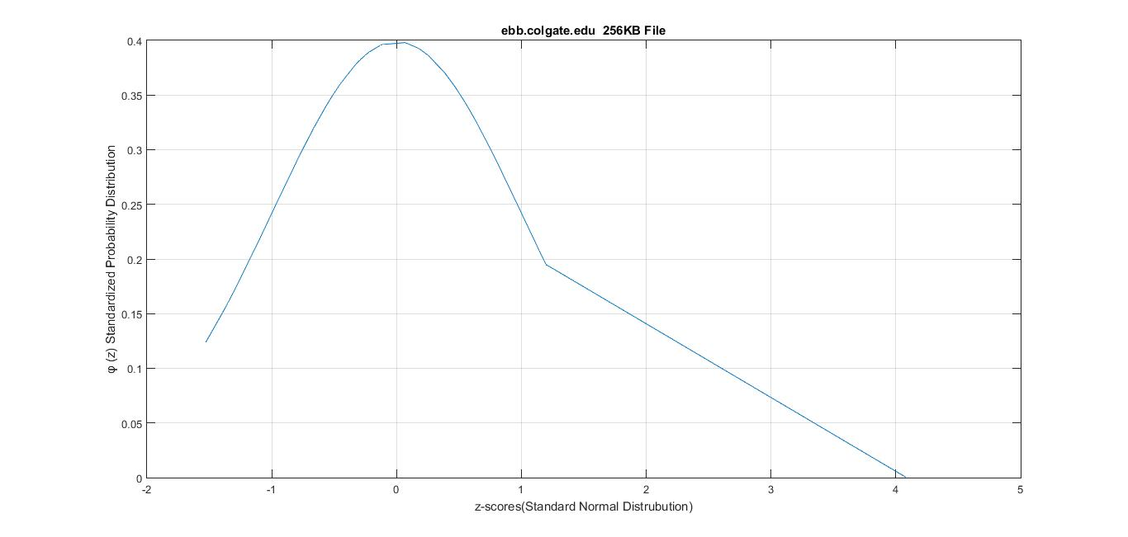
Data Presentation-Graphs(Cont..)
Distribution of measurements for ebb.colgate.edu for 256KB file

Slide 48
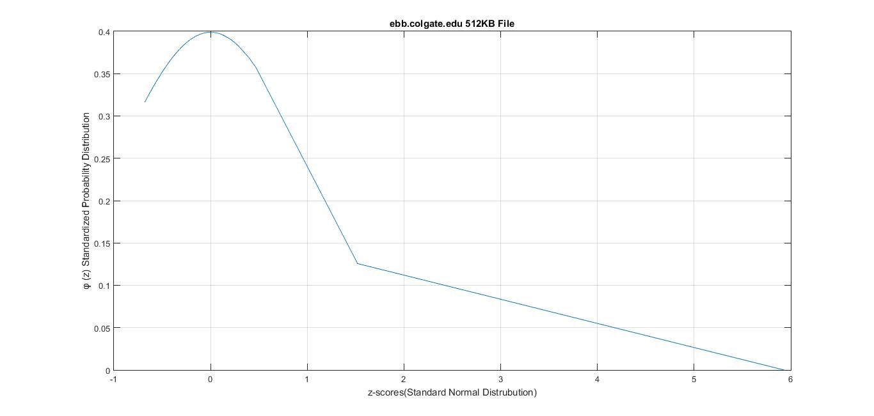
Data Presentation-Graphs(Cont..)
Distribution of measurements for ebb.colgate.edu for 512KB file

Slide 49
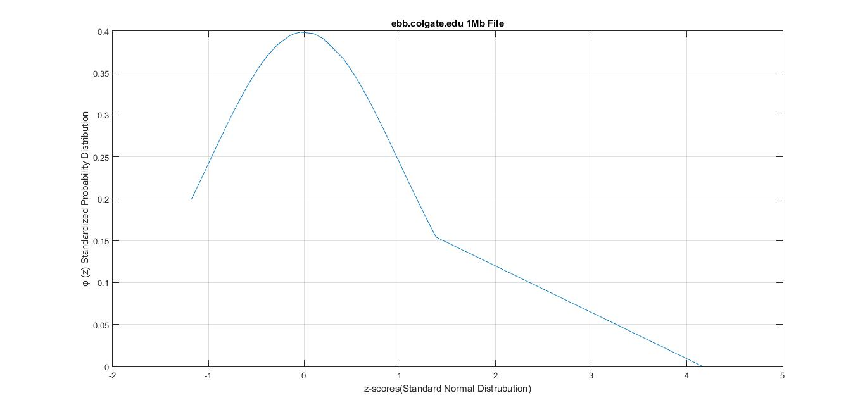
Data Presentation-Graphs(Cont..)
Distribution of measurements for ebb.colgate.edu for 1MB file

Slide 50
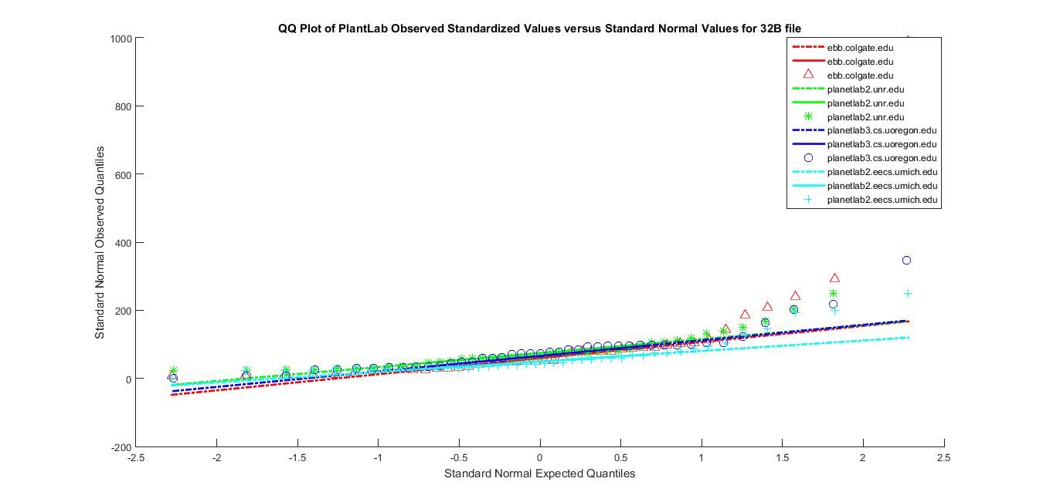
Data Presentation-Graphs(Cont..)
Q-Q plot for 32B file for 4 PlanetLab nodes:ebb.colgate.edu,planetlab2.unr.edu,planetlab3.cs.uoregon.edu,planetlab3.eecs.umich.edu

Slide 51
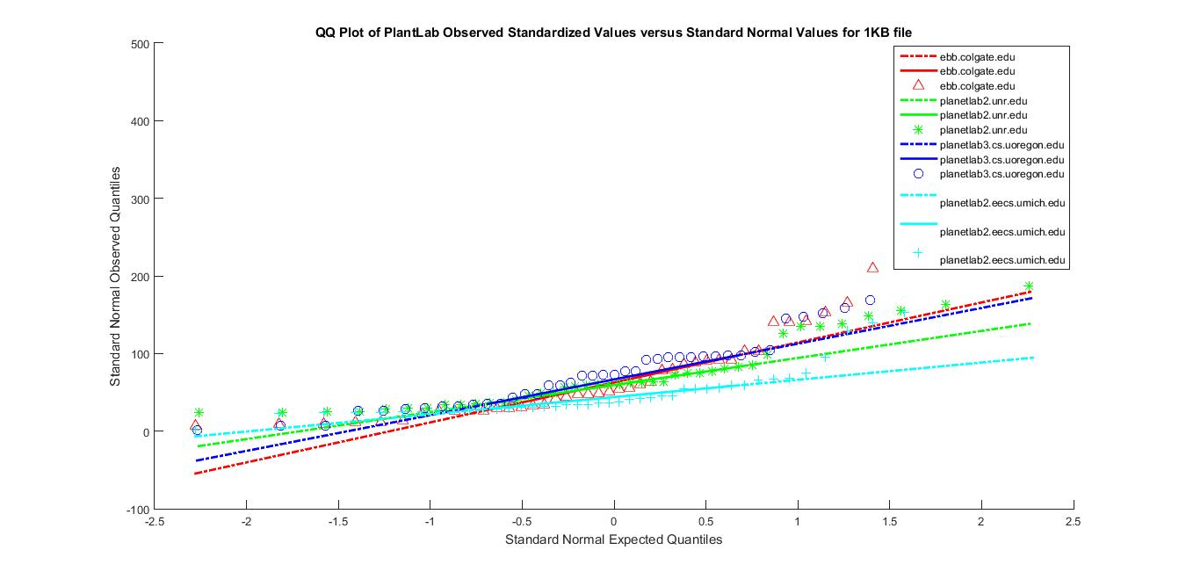
Data Presentation-Graphs(Cont..)
Q-Q plot for 1KB file

Slide 52
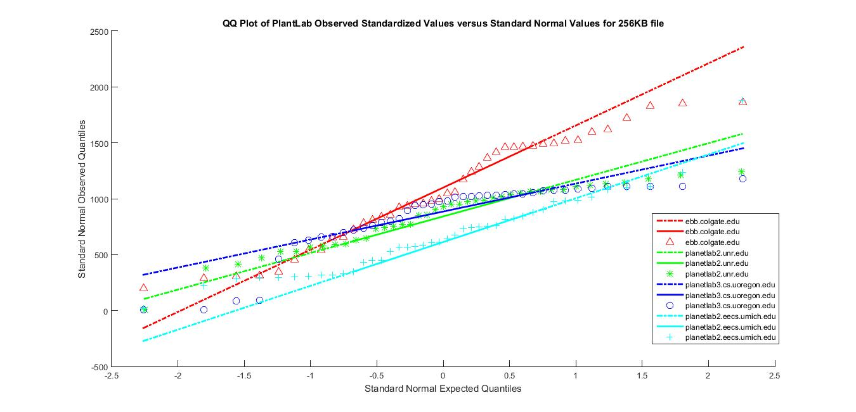
Data Presentation-Graphs(Cont..)
Q-Q plot for 256KB file

Slide 53
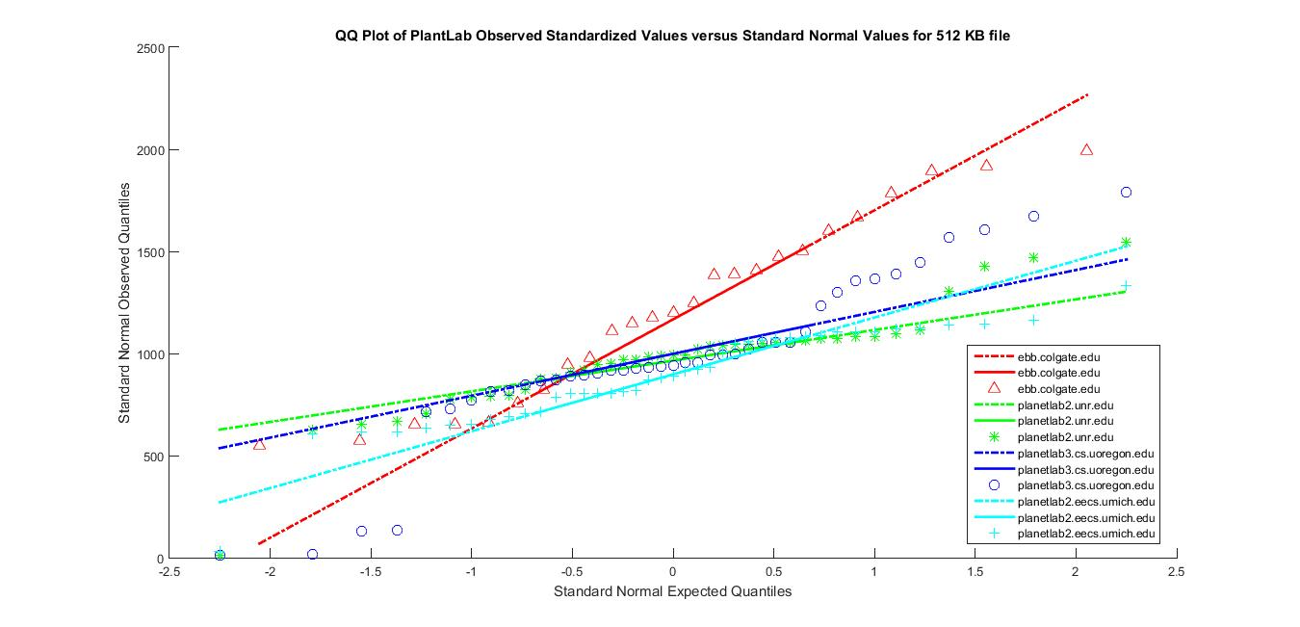
Data Presentation-Graphs(Cont..)
Q-Q plot for 512KB file

Slide 54
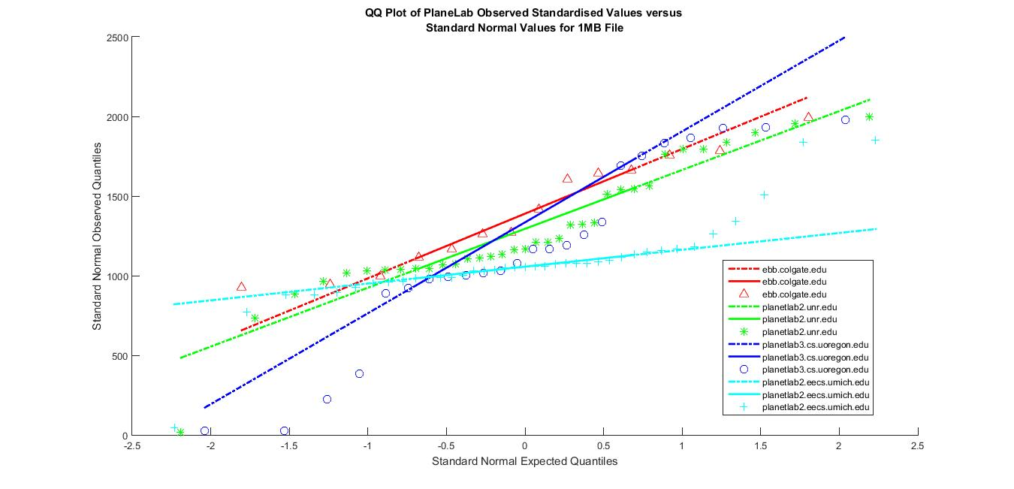
Data Presentation-Graphs(Cont..)
Q-Q plot for 1MB file

Slide 55
Error Correction Techniques
In order to minimize errors due to delays, we have explored 3 error correction functions.
Linear Regression
Weighted Least Mean Squares(LMSQ)
K Nearest neighbour

Slide 56
Linear Regression
Linear regression is an approach for modeling the relationship between a dependent variable y and one or more independent variables denoted x.
It is used extensively in practical applications. This is because models which depend linearly on their unknown parameters are easier to fit than models which are non-linearly related to their parameters and because the statistical properties of the resulting estimators are easier to determine.

Slide 57
R language
Tool used : R language
R is a language and environment for statistical computing and graphics
R provides a wide variety of statistical (linear and nonlinear modelling, classical statistical tests, time-series analysis, classification, clustering, …) and graphical techniques, and is highly extensible
R is available as Free Software

Slide 58
R Language
It includes
an effective data handling and storage facility
graphical facilities for data analysis
a well-developed, simple and effective programming language which includes conditionals, loops, user-defined recursive functions and input and output facilities

Slide 59
Weighted Least Mean Squares(LMSQ)
This method is a standard approach in regression analysis
The most important application is in data fitting
Find the peak values from probability distribution of distance to delay for a particular rtt(S,H)

Slide 60
LMSQ (contd..)
Error is calculated for each peak with:
Err(P,S,L)=(d(P)-d(S,L))² /prob(P)
d(p)- distance of P
prob(p) – probability of P

Slide 61

LMSQ (contd..)
Among these values, minimum value of error measure is computed with respect to Source
error(S,L)= min_{p}(err(P,S,L))
Error measure for all sources is the sum of total error measures from different sources
error(L)= sum_{s}(error(S,L))

Slide 62
K Nearest Neighbours
It is a non parametric method used for classification and regression
The output depends on whether k-NN is used for classification or regression
In k-NN classification, the output is a class membership. An object is classified by a majority vote of its neighbors, with the object being assigned to the class most common among its k nearest

Slide 63
KNN r
If k = 1, then the object is simply assigned to the class of that single nearest neighbor
In k-NN regression, the output is the property value for the object. This value is the average of the values of its k nearest neighbors
The best choice of k depends upon the data; generally, larger values of k reduce the effect of noise on the classification

Slide 64
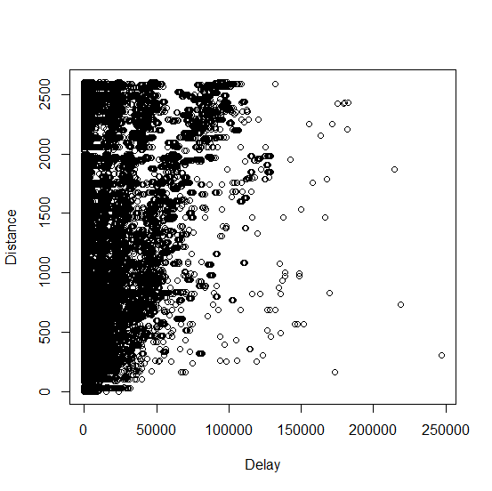
Experimental Results

Slide 65
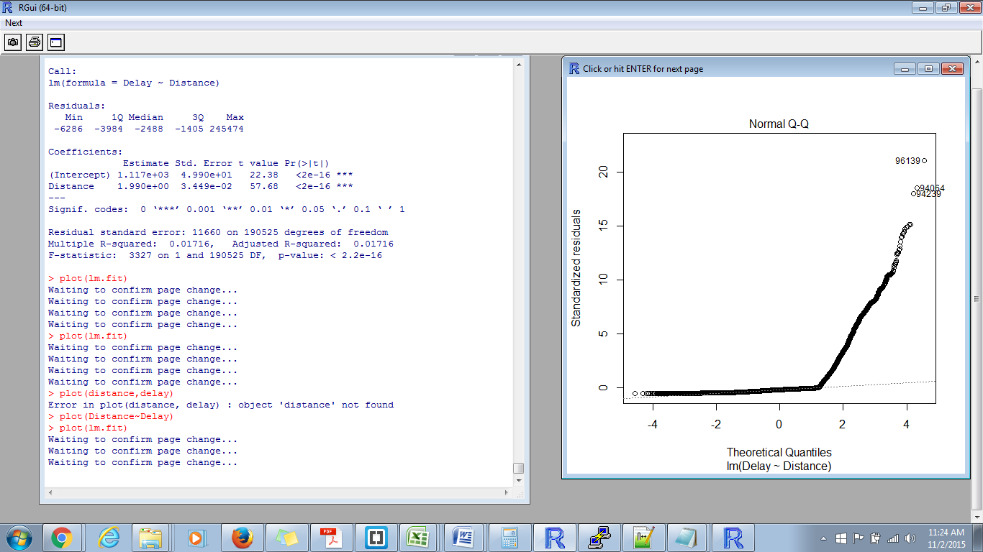
After Error Correction

Slide 66
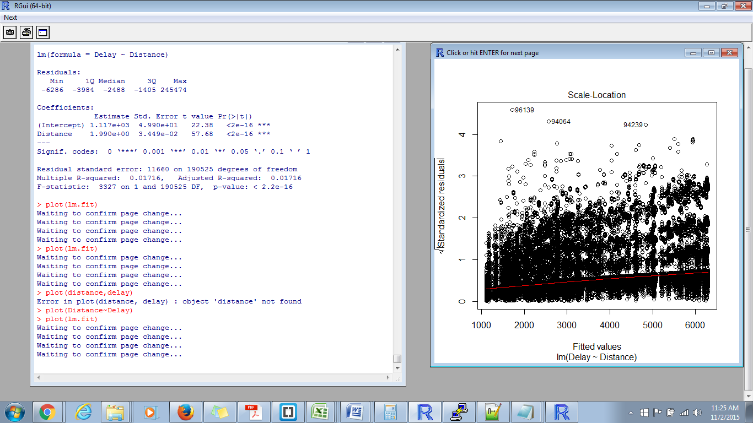
After Error Correction

Slide 67
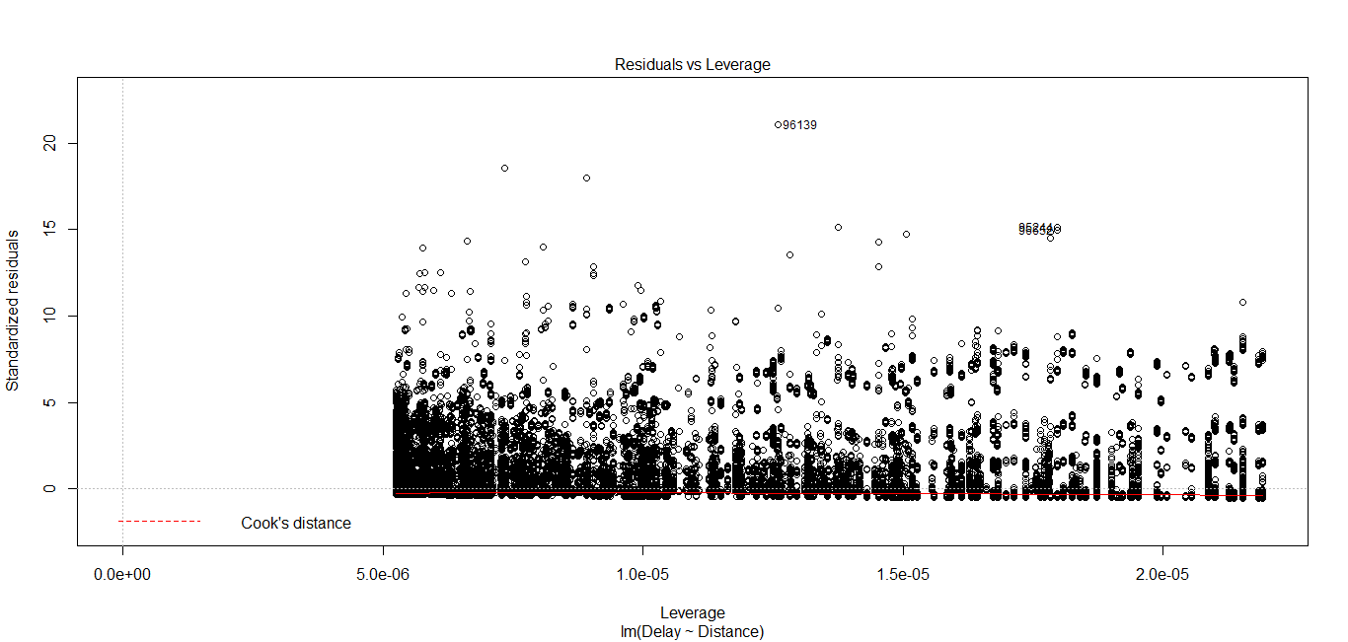
After Error Correction

Slide 68
Conclusion
The error is reduced using the Linear Regression method

Slide 69
References
http://napl.gmu.edu/pubs/CPapers/YounMarkRichards-ICCCN09.pdf
https://en.wikipedia.org/wiki/Round-trip_delay_time
http://searchnetworking.techtarget.com/definition/round-trip-time
https://tools.ietf.org/html/rfc1323
http://www3.cs.stonybrook.edu/~phillipa/papers/SPECTS.pdf
http://cs.unc.edu/~jasleen/papers/imc03.pdf
Determining the Geographic Location of Internet Hosts by VenkataN. Padmanabhan and Lakshminarayanan Subramanian

Slide 70
References(Contd..)
http://www.statemethods.net/graphs/line.html
http://www.statemethods.net/input/contents.html
http://www.statemethods.net/blog/?p=779

